Slide 1
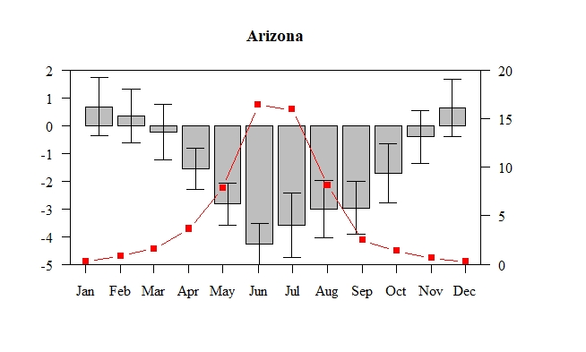
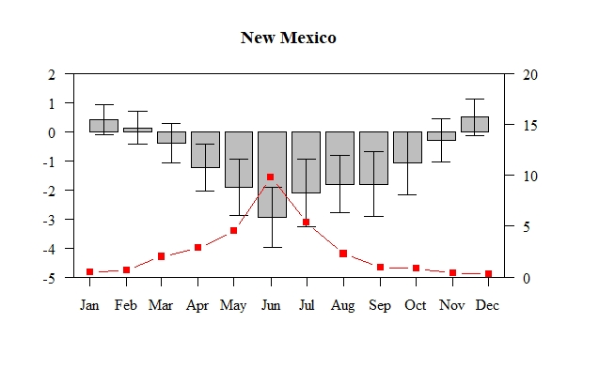
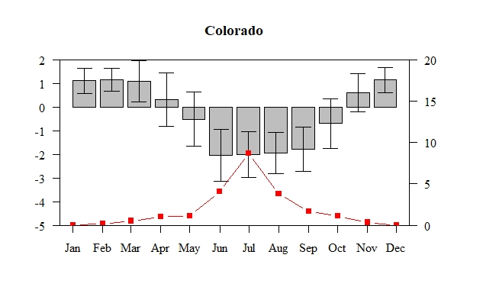
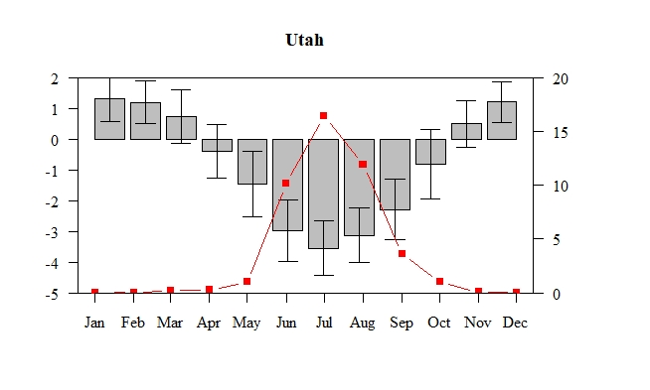
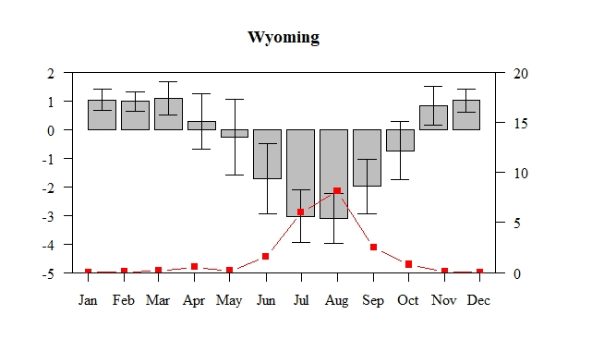
Precipitation – PET (in), Statewide Average
Average monthly wildfires, 1980-2016
Wildfire data size class greater than 100 acres; prescribed, false alarm, and assisted fires not included in count; data obtained from https://wildfire.cr.usgs.gov/firehistory/data.html
PET calculated using Thornthwaithe method; precipitation and temperature data obtained from https://wrcc.dri.edu/wwdt/

